Slide 2
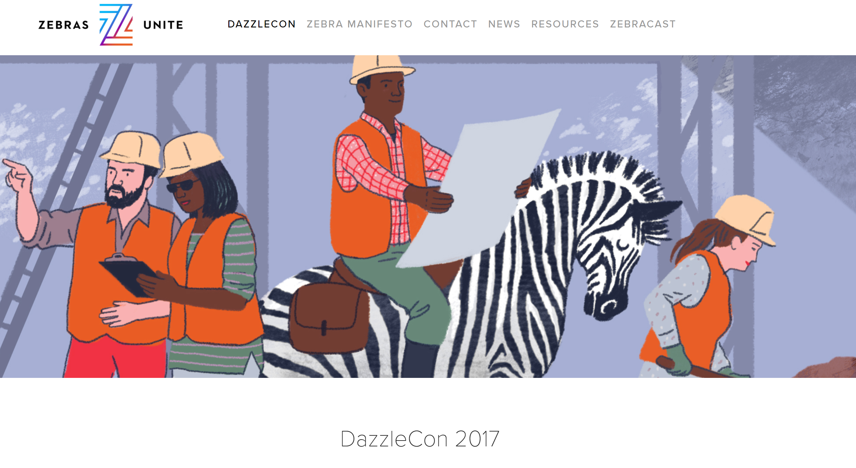

Slide 3
If Angels Invest in Unicorns, Do Heroes, Champions, and Catalysts Invest in Mustangs, Thoroughbreds, and Clydesdales?

Slide 4
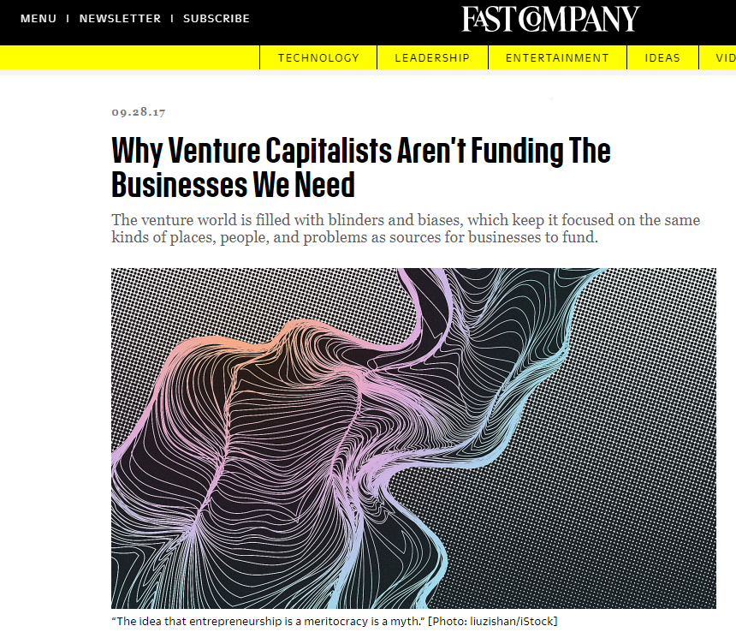

Slide 5
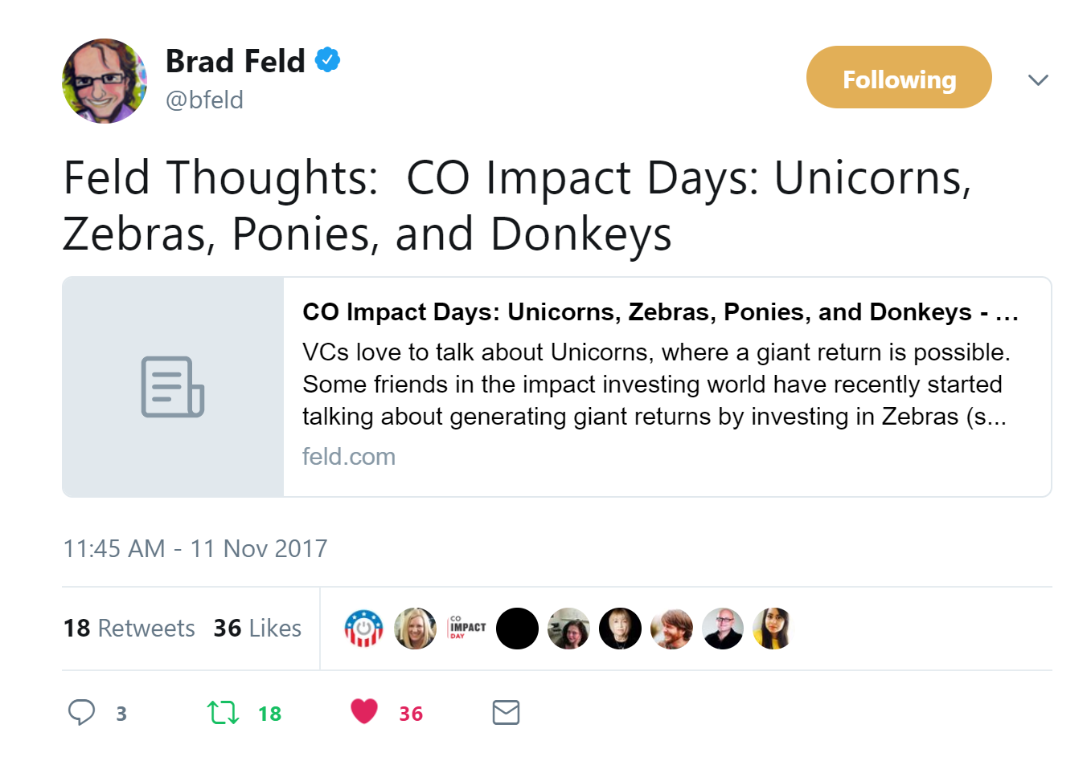

Slide 6
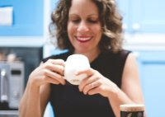
Linda Appel Lipsius
Orange Glo – Oxyclean
Tetulia
the mama’hood

Slide 7
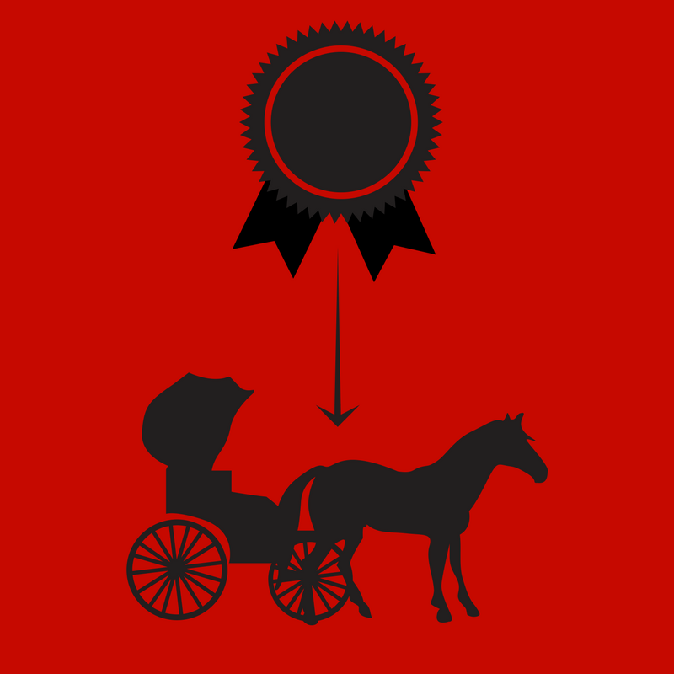
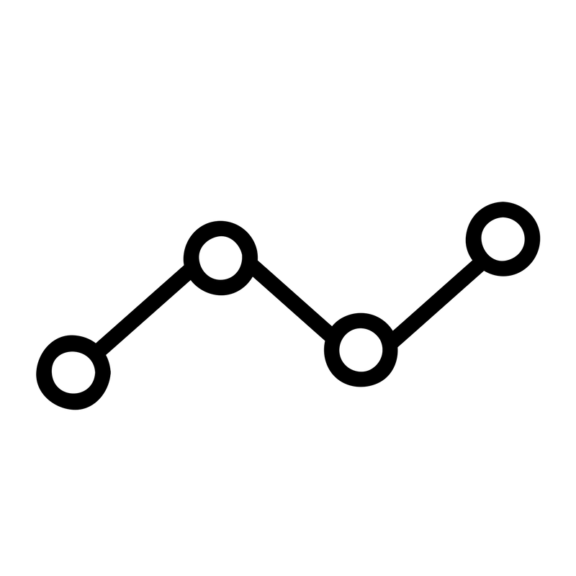
Nonprofit Clydesdale Mustang Stallion Unicorn
Donor Champion Catalyst Hero Angel
-100% -65% 0% 2X 10X
Notes:
2

Slide 8
Angels & Unicorns?
Financial Return: 10x Return
Impact: Low
Structure: C Corporate
Description: App
Investment Type: Convertible Note
Risk: Moderate

Slide 9
Heroes & Zebras
Financial Return: 2x Return
Impact: Moderate
Structure: Public Benefit Corporate
Description: Application + Bricks & Mortar
Investment Type: Royalty
Risk: Moderate

Slide 10
Catalysts & Mustangs?
Financial Return: 10% Return
Impact: High
Structure: Public Benefit Corp
Description: App + Bricks & Mortar
Investment Type: Royalty
Risk: Moderate

Slide 11
Champion & Clydesdales?
Financial Return: 10% Return
Impact: High
Structure: Public Benefit Corp Owned by Nonprofit
Description: App + Bricks & Mortar
Investment Type: Royalty
Risk: Moderate

Slide 12
Nonprofit Clydesdale Mustang Zebra Unicorn
Donor Champion Catalyst Hero Angel
-100% -65% 0% 10% 30%

Slide 13
What is your vote for the mama’hood?
Unicorn 10x
Zebra 2x
Mustang 0%
Clydesdale -65%
Nonprofit -100%

Slide 14
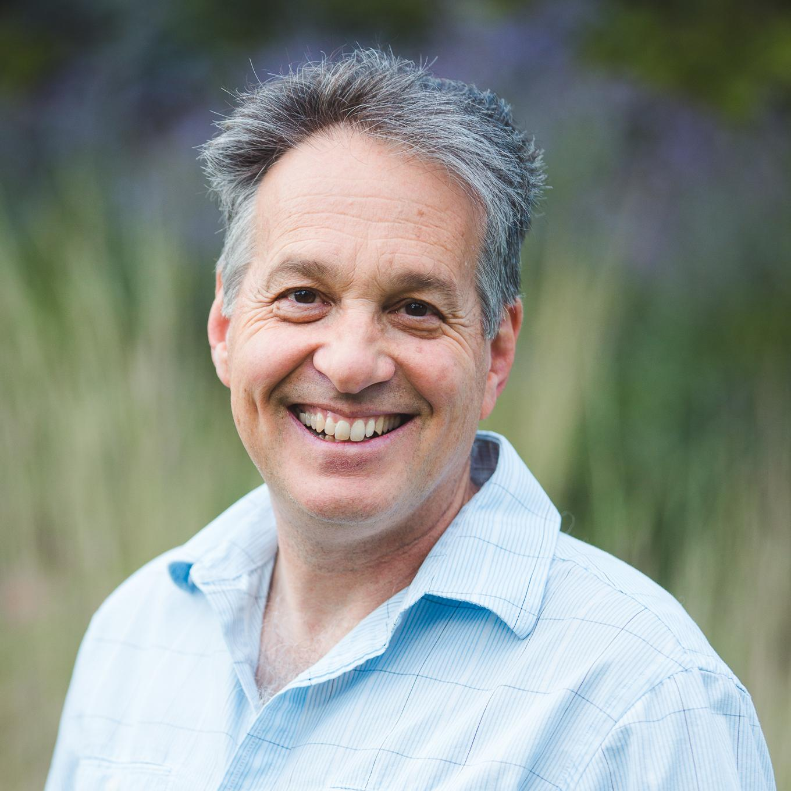
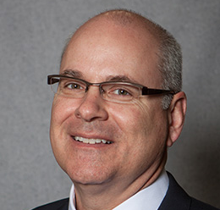
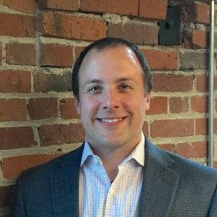
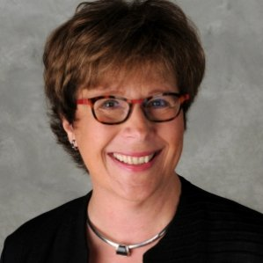
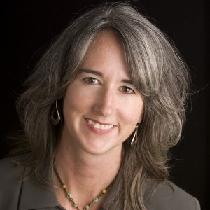
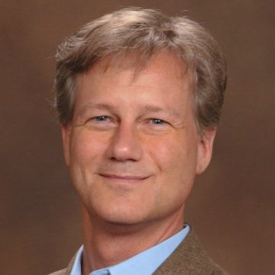
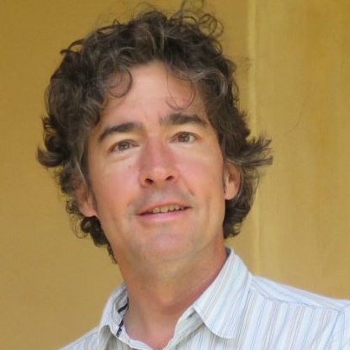
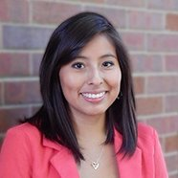
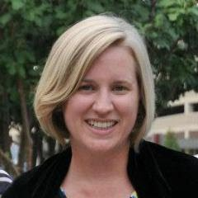
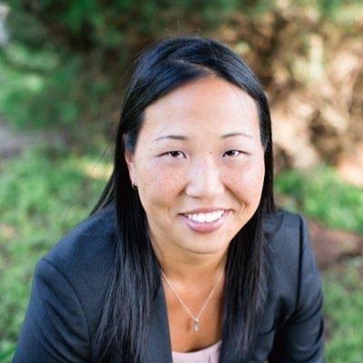
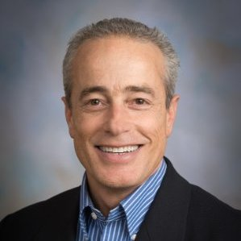
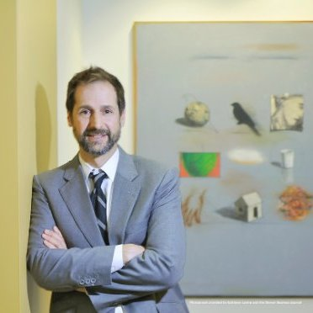
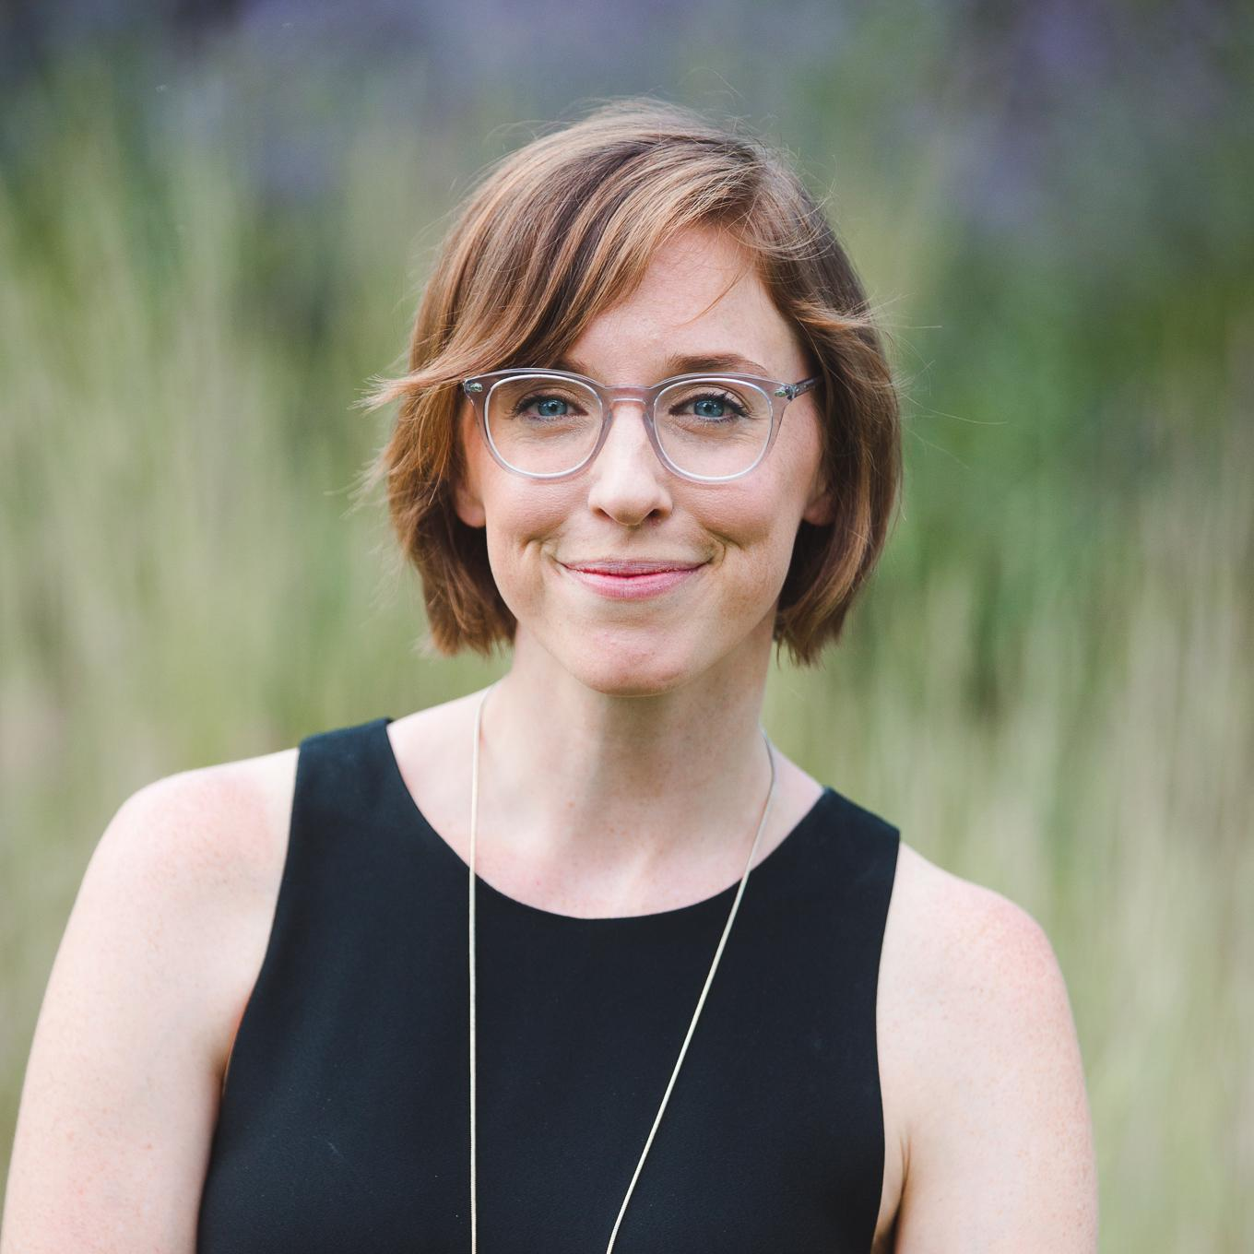
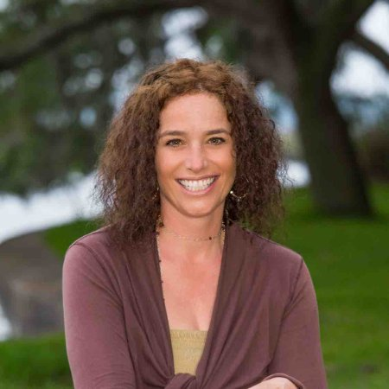
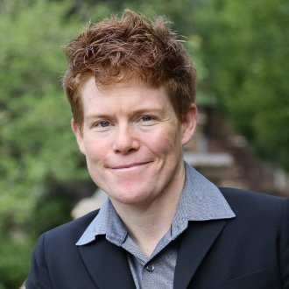
Notes:
Kristin Giant
Change John C with John O
Add Greg
Add Karen
Add Mei

Slide 15
Philanthropy is an investment All investments have impact

Slide 16
Investor Readiness Workshop
"It's super rare to get world class portfolio advice from someone who doesn't have their hand in your pocket. It's rarer to get a whole new framework for thinking about donations and philanthropic work. Rarest is all is a combination of clear next steps and challenge to take action. Stephanie Gripne and John O'Halloran of the Impact Finance Center deliver a trifecta.“
- Jonathan Kauffman, Seattle

Slide 17
How do we move $1 Trillion?
Notes:
so the vision you are we are about ready to share with you is our answer to Matt Baker at the Hewlett foundation in terms of how do we design a system to move another trillion dollars.

Slide 18
$1 Billion at a Time
Notes:
Which leads us to the question of how to move $1 trillion
$1 billion at a time
How do you move a billion dollars?
One transaction or one investment portfolio at a time

Slide 19
$50 Million at a Time
Notes:
Which leads us to the question of how to move $1 trillion
$1 billion at a time
How do you move a billion dollars?
One transaction or one investment portfolio at a time

Slide 20
Notes:
Which quickly leads us to what we call the chicken and the egg problem

Slide 21
$38 Trillion
Finance First
$25M Minimum
Minimum $1 Billion
Investment Vehicle
Positive Impact
401K and IRA
Notes:
Jason/Amalgamated Bank – can you chime in on these questions?
Which pension fund? CO PERA?
Which school? CSU Foundation – since in CO and they are trying?
Which foundation? Should we ask AARP? MacArthur?
On one hand we have $38 trillion of US institutional capital here we have represented since were in Colorado the Colorado para-pension fund Colorado State University foundation is committed to be investing in Colorado and AARP foundation
the simple fact of the matter is when you’re dealing with assets this day these trustees and fiduciaries have finance first mandate
and their minimum investment size is often $25 million and they cannot be more than $250 million of certain investment opportunity
that said all things being equal their completely allowed if not encouraged to look at investments a positive impact or alignment with their mission
So let’s focus on AARP foundation they are a foundation their condition with over $3 billion in assets whose mission is to support the aging population

Slide 22
Notes:
On the other hand we have Silvernest. Silvernest is an online technology solution for the aging population to get housemates for the purposes of additional income help around the house or companionship the company was designed to help that heart 40% of the aging population will save less than $50,000 for the purposes of aging in place. Every day this population ages in place they are happier healthier and they send taxpayers a lot of money.
Permanent perspective it’s an interesting company in that it’s women lad by CO Wendi Burkhardt it’s a gene intergenerational connectivity affordable housing economic developments and health

Slide 23
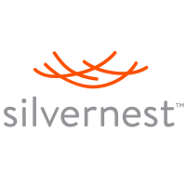
How it could work…
Investor Education
Governance
Investment
Beliefs
Attribution
Evaluation
Philanthropic
Assessment
Investor
Investment
Advisor
Manager
(Aging)
Funds
(Aging)
Social Venture
startup
bootstrap
small
seed
growth
venture
IPO
exit
Positive Impact
medium
large
HUGE
small
Notes:
However this is how we experience the current state of affairs
the state of most investors fitness is low and there in great need of education they do not have proper governance in place which includes investment beliefs evidence misattribution evaluation and impact
even if the investor has great fitness when they go to their investment advisor and asked to see managers such as aging there are not aging managers out there that meets the criteria financial return risk liquidity and impact at the $500 million billion dollar level to bring to the impact investor for investment
hence the social venture has difficulty getting access to capital in fact can even be penalized for being focused on impact
and hence we see a lost opportunity for making positive impact in the aging space

Slide 24
How it does work…
Investor Education
X
Investment
Beliefs
Attribution
Evaluation
Philanthropic
Assessment
Governance
Investor
X
X
Investment
Advisor
Manager
(Aging)
Funds
(Aging)
Social Venture
startup
bootstrap
small
seed
growth
venture
IPO
exit
X
Positive Impact
X
HUGE
small
medium
large
Notes:
However this is how we experience the current state of affairs
the state of most investors fitness is low and there in great need of education they do not have proper governance in place which includes investment beliefs evidence misattribution evaluation and impact
even if the investor has great fitness when they go to their investment advisor and asked to see managers such as aging there are not aging managers out there that meets the criteria financial return risk liquidity and impact at the $500 million billion dollar level to bring to the impact investor for investment
hence the social venture has difficulty getting access to capital in fact can even be penalized for being focused on impact
and hence we see a lost opportunity for making positive impact in the aging space

Slide 25
Problem(s)
leaving money, impact, and risk on table (e.g. + governance)
needs impact investments
needs impact investment capital
Notes:
In short we have three problems
Investor fitness we are leaving money impact risk on the table that could be fixed with improving governance
secondly the investors need access to high-quality impact investment product
three the social venture needs access to capital

Slide 26
How do we fix it?
Inventory, educate, and activate philanthropists and investors
Inventory, educate, and activate social ventures
Scale regionally and replicate across regions
National Impact Investing Marketplace!
Notes:
How do we go about fixing this problem at scale?
Threefold one we have the inventory educate and activate philanthropists and investors to become impact investors to we have to inventory educate and activate the social ventures which are projects nonprofits for-profits and funds at a state wide scale
three we need to scale these market places regionally and replicated across 10 regions and the results would be the national impact investing marketplace

Slide 28
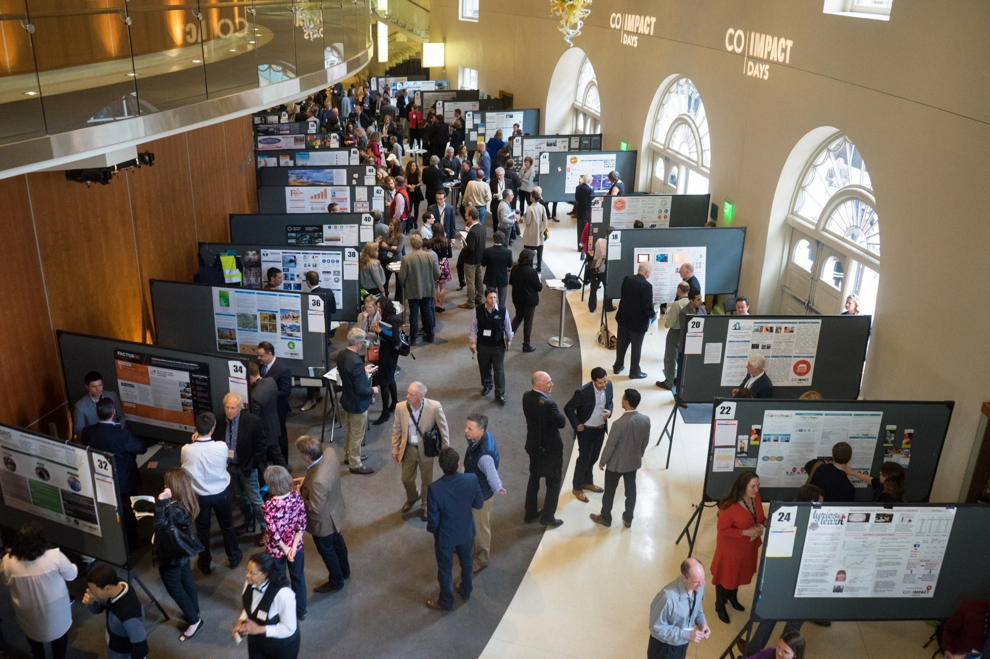

Slide 29
How many impact investments?
iCast
Mi Casa
Museum of Contemporary Art
Silvernest
Somalia
TOD Fund
Impact Finance Center
All Health
Grassland Conservation Project
Anonymous
Calvert Foundation
Colorado Lending Source
Alliance Center
Silva Cycle
Give2Get
Poudre Valley Farms
JoyBox

Slide 30
Notes:
This so how would this work?

Slide 31
Notes:
We believe that if you take any community identity place or interest such as the aging and you community that we can source $50 million of high-quality investment opportunities between debt and equity per state. Think about three or four senior citizen homes a couple of Silvernest’s in a couple of exciting nonprofit social enterprises.

Slide 32
Notes:
If every state in the Rocky Mount region did that we would then source $300 million of high-quality deal flow

Slide 33
Notes:
which means that nationally we would actually source three $3 billion of aging deal flow which would mean that now we would have enough pipeline to develop institutional products for aging managers to exist and for AARP foundation to be able to take their endowment and invest in aging.

Slide 34
Notes:
So how would this work?

Slide 35
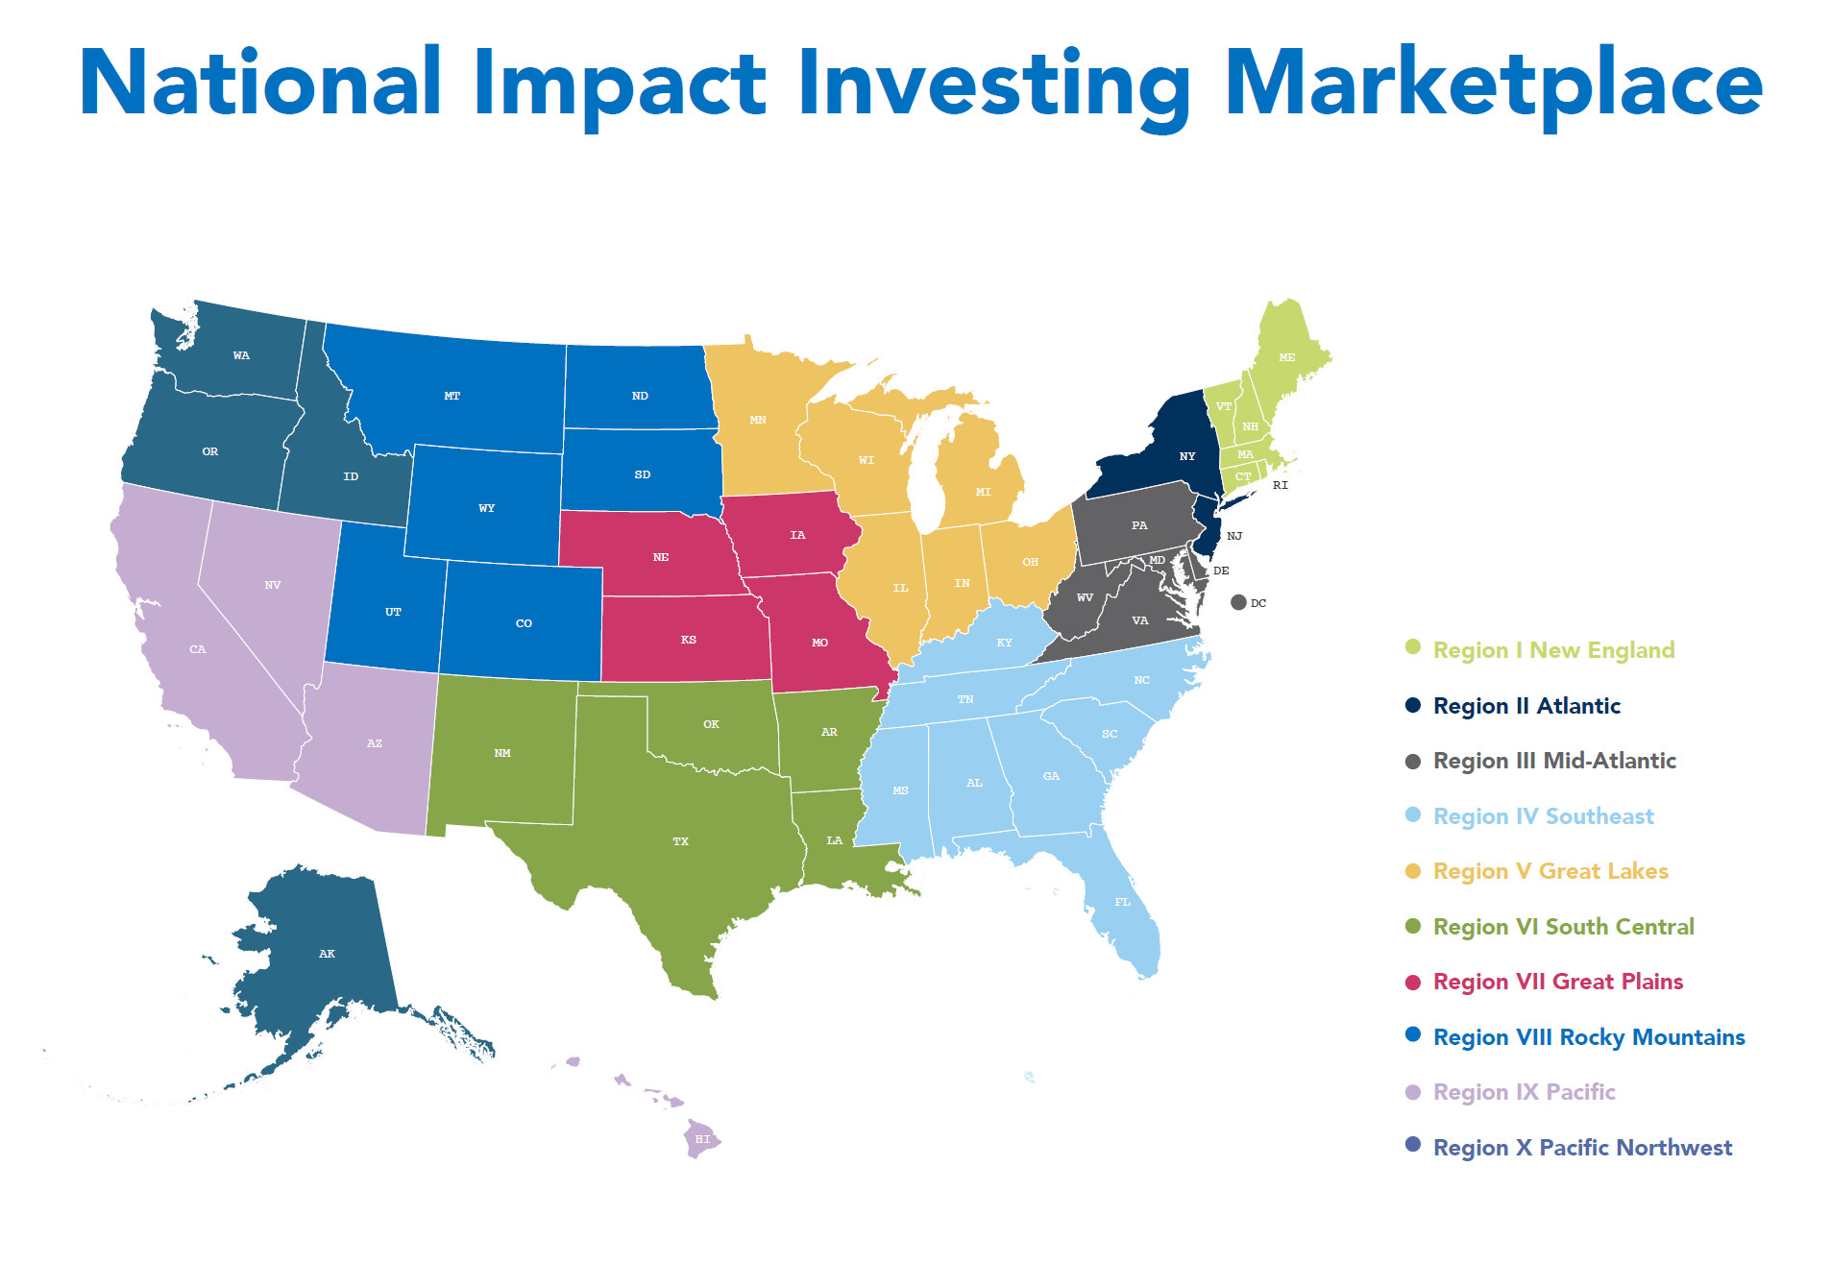
Notes:
Using the SBA 10 regions as the regional framework to form the marketplaces

Slide 37
Toolbox
Impact Investing Giving Circles
Impact Scans

Slide 38
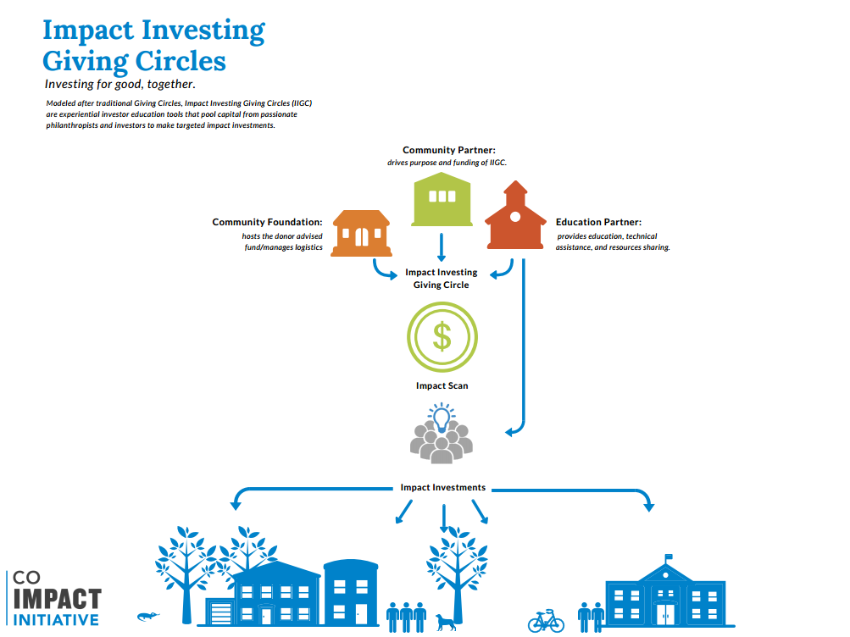
Notes:
Access to Care: Primary Care
Behavioral Health
Healthy Children and Adolescence
Social Determinants
Healthy Communities
Healthy Behavioral

Slide 39
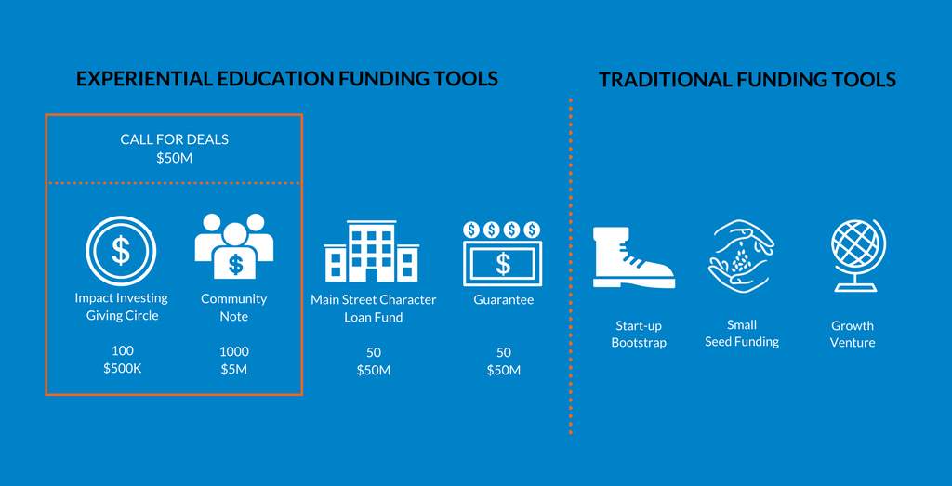

Slide 40
2018 Impact Investing Giving Circles
Food
Rural Community Reinvestment
Conservation
Women
Immigrant & Minority

Slide 41
Participation Guide
Social Venture Marketplace
Impact Investing Giving Circles
Impact Investing Education Institute
Impact Investing 101 & CO Impact Days and Initiative Presentation
Nonprofit and Impact Investing Course
For Profit and Impact Investing Course
Investor Readiness Workshop
3 Day Investor User Conference
100 Social Ventures

Slide 42
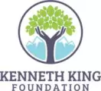
THANK YOU TO OUR SPONSORS & SUPPORTERS
Special Thanks to Individual & Founders Circle Supporters:
A.J. Grant, Andrew Currie, Doug Spencer, Karen Brown,
Mark Newhouse, Martha Davis,
Matt Moskal, Praful Shah, & Rich Hoops.

Slide 43
Dr. Stephanie L. Gripne
@PrimeHealthCO
@StephanieGripne
@ImpactFinCtr
@COImpactDays
#COImpactDays17

