Slide 1
How to Work with IRS: Strategies for Estate and Gift Tax Attorneys
For Rocky Mountain Estate Planning Council
October 24, 2012
Michael Gregory
Michael Gregory Consulting LLC

Slide 2
Presenter
Michael Gregory, Chief Manager, Michael Gregory Consulting LLC since September 12, 2011
Formerly IRS 28 Years as Engineer and Valuer, Manager, Operations Team Lead, Controller, Acting Assistant District Director, Territory Manager
Qualified Neutral Supreme Court in MN, ASA, AVA, and MBA

Slide 3
Michael Gregory Consulting LLC
Risk Management, BV Review, and IRS Assistance
Alternative Dispute Resolution
Strategic Planning and Value Added Services
Will Go Over Some Examples
Could be of Service to You and Your Clients
mg@mikegreg.com
651-633-5311

Slide 4
Disclaimer
The opinions presented here are those of Michael Gregory. Michael Gregory does not represent the IRS. Any opinions presented in this seminar are those of the author and do not represent an official position of his current or previous employers. This material is offered for educational purposes only. The author and his employer expressly disclaim any liability, including incidental or consequential damages, arising from the use of this material or any errors or omissions that may be contained in it.

Slide 5
Today’s Presentation
IRS Background
Estate and Gift Tax at the IRS
IRS Classification and Processing
Steps You Can Take
Working With the IRS on Valuation Issues
Issue Resolution

Slide 6
IRS
Eleven Divisions
Compliance – Four Divisions
Appeals
Counsel – IRS and DOJ Tax Litigation Division
Your Primary Interest as Estate and Gift Tax Attorneys are with the Small Business and Self Employed Division, (SBSE) but could relate to the Large Business and International (LB&I)or Tax Exempt and Governmental Entities Division (TEGE)
Focus On SBSE Estate and Gift Tax with Tie in LB&I Field Specialist – Engineering Program where IRS Business Valuators and Appraisers are Located

Slide 7
www.irs.gov
“Estate and Gift”
  Forms and Publications
    Pub 950 Intro to E&G Taxes – Marketing Information
    From 709 US Gift (and Generation Skipping Transfer) Tax Return
    SOI Statistics
    What’s New in Estate and Gift
Audit Technique Guides – Aerospace to Wine with over 50 Topic Areas (See auditing Attorneys)

Slide 8
Small Business Self Employed Division
Examination and Collection Functions
Examination
  General
  Estate and Gift
    Classification Process (Cincinnati and Ogden Service Centers)
      706 and 709 to Cincinnati
      Certain Projects Ogden
    Owner of Case (E&G Manager with Estate Tax Attorney)
Counsel

Slide 9
Large Business and International Division
Six Industries and One Support Function
CTM, FS, HMT, NRC, RFPH, and GHW
Field Specialists
  Engineering and Valuation
    Note Geographic Location
    Note Specialization
  Employment Tax
  Computer Audit Specialists
  Financial Products
Counsel

Slide 10
Engineering Program
Why Engineering Title?
Internal Consultants to All Divisions
Four Territory Managers
32 Front Line Managers
300 Technical Employees
Valuators Locally – Real Property and Business Valuation
Know Who They Are and Invite Them to Professional Meetings

Slide 11
Appeals Division
Case Closes Out of Examination Unagreed and Goes to the Internal IRS Appeals Division
Goal to Settle Cases
Independent
Ex Parte Rules
Ways to Approach

Slide 12
Counsel
IRS Office of Chief Counsel
  Operations
  Technical
    All Non Litigation Work (legislative, regulation, interpretation)
    Corporate
    International
    Technical Advice
IRS Division Counsel
IRS Special Trial Counsel
DOJ Tax Litigation Division

Slide 13
Issue Resolution at the IRS
Issue Resolution
  Lowest Level
  Emphasis on Timeliness, Understanding, Enforcement, Integrity, Fairness
  Factually Oriented – Resolution; not Hazards of Litigation
Division Dependent
What Level and With Whom are the Key?

Slide 14
Formal Process in Mediation in SBSE General Program
Managers and Employees “Trained”
Awareness There
Recent Commissioner Report on the Process
  More Authority Needed at Front Line Level
  More Training Needed
242 Cases with 572 Returns
124 Cases or 51% Fully Resolved
Average Time Frame 86 Days – Goal 60 Days – Now at 104 Days
Normal Case Not in Formal Mediation – When to Elevate and to What Level?

Slide 15
Informal Process in LB&I
Field Specialists Engineers and Valuators Trained in Mediation
  Informal Process
  Model – FIFI
    What are the Facts?
    What are the Issues?
    How do you Feel about this?
    What are your Interest?
    Now lets explore solutions.

Slide 16
LB&I Field Specialists Informal Process in Mediation
Over 400 Employees Trained in the Process of Mediation
DVD Made for New Hires
Elevation in Management is Sometimes Needed to Explore the Process
Elevating in Management is Encouraged When Differences Are Associated with Other Than The Technical Issue
If Not Resolved When to Elevate and to What Level?

Slide 17
Let’s Go Over Some Review Questions
Who Owns the Case?
Who Manages the Case?
What is the Role of the Valuator?
If you Have Frustrations with the E&G Attorney Who Should You Contact?
If you Need a Real Property Appraiser or Business Valuator What Should You Do? Coming up Next…

Slide 18

Let’s Have Fun with Some
Real World Examples

Slide 19
Examples for Discussion
SBSE Examination Case with a Business Valuation Issue
  Boston, Florida, New York, North Carolina, Philadelphia
  San Francisco, San Antonio
SBSE Examination Case with IRS Counsel or DOJ
  Understand Roles of Attorney and Appraiser
  Work to Resolve – Prepare Report for Judge
SBSE Case at Appeals
  Understand ExParte
  Understand New Information and Mediation

Slide 20
Examples For Discussion Continued
LB&I and SBSE Planning
  Initiate Process with High Wealth Individuals Ahead of Time
  Family Issues – Mediation Approaches
  Plan Out Company and Wealth Transfer
6695A Appraiser Penalties Impact on Appraisers
  Know the Rules
  Appraisers Need to Follow Standards
6661 Overvaluation and Substantial Understatement Penalty on Return

Slide 21
Important Take Away Information
Know Who Your Working with at the IRS
Understand the Role of Participants
Seek to Understand Interests
Do Not Be Afraid to Ask Questions
Consider Options
  Ask for a Business Valuator or an Appraiser
  Ask to Elevate in Management as a Neutral Party Given Ownership of the Issue by the RA or ETA

Slide 22
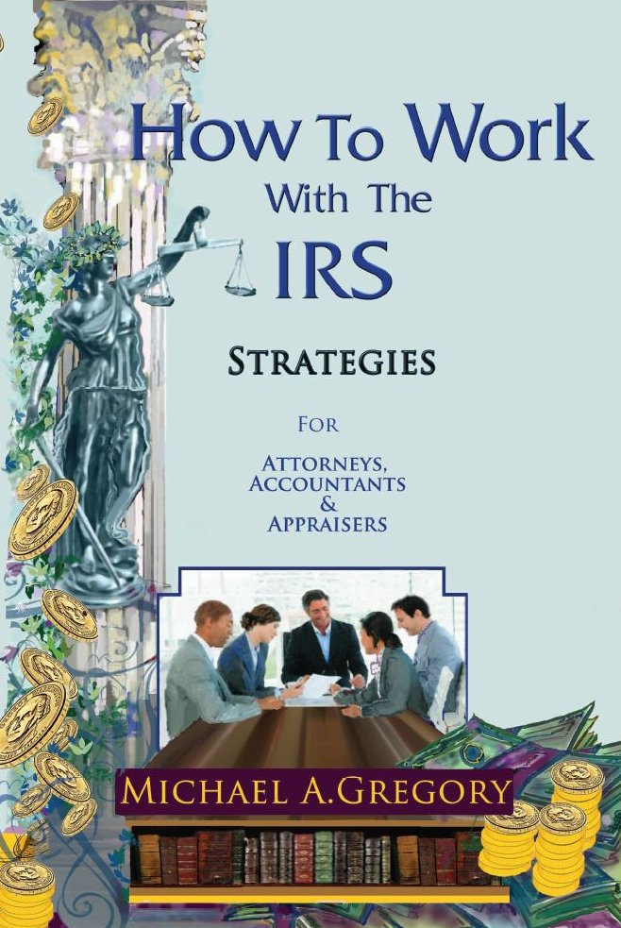
How to Work with the IRS: Strategies for Attorneys, Accountants and Appraisers

Slide 23
Summary of Chapters
IRS Official and Unofficial Rules of Engagement
IRS Organization
My History and Best Practices
Issue Resolution and Mediation at the IRS
Classification in General and Estate and Gift in Particular
Potential Penalties on Appraisers
Reasonable Compensation in Corporations
Discounts for Lack of Marketability
Most Common Errors in Valuations
Strategic Growth Areas of Business Valuation Appraisers
Other Engineering Issues and Valuation Related Issues
Strategic Thinking
Overall Commentary and “Do’s and Don’ts”

Slide 24
Contact Information
Michael Gregory Consulting, LLC
mg@mikegreg.com
www.mikegreg.com
651-633-5311
1945 Sharondale Ave.
Roseville, MN 55113
Contact me with any questions or concerns

Slide 25
What Are Your Thoughts and Questions

